Slide 1

Extending the Distributed Service Profiler
Shelley Lowe
4950257
BTech 451 Project
Final Seminar

Slide 2
Project Overview
An existing Distributed Service Profiler is used to display information about the communication (calls) between services
Problems with the current profiler
Current capabilities of profiler does not include displaying information of calls made by services to the database
Developers want to know what/where queries are made to help find bottlenecks of the service and improve their code
Goal of this project is to extend this profiler to integrate the database layer

Slide 3
Profiler – Background Information
Connects to services using sepcified port number
Currently displays calls made between services and information of these calls
Information includes method name, time taken to process, argument and return bytes and number of hits
Different services are used to control different things such as a manufacturing service and a core service
The ManufacturingService may need to find a specific job, so will call the MapCoreService with a query findJobByID. This service might then query the database which returns the relevant job

Slide 4
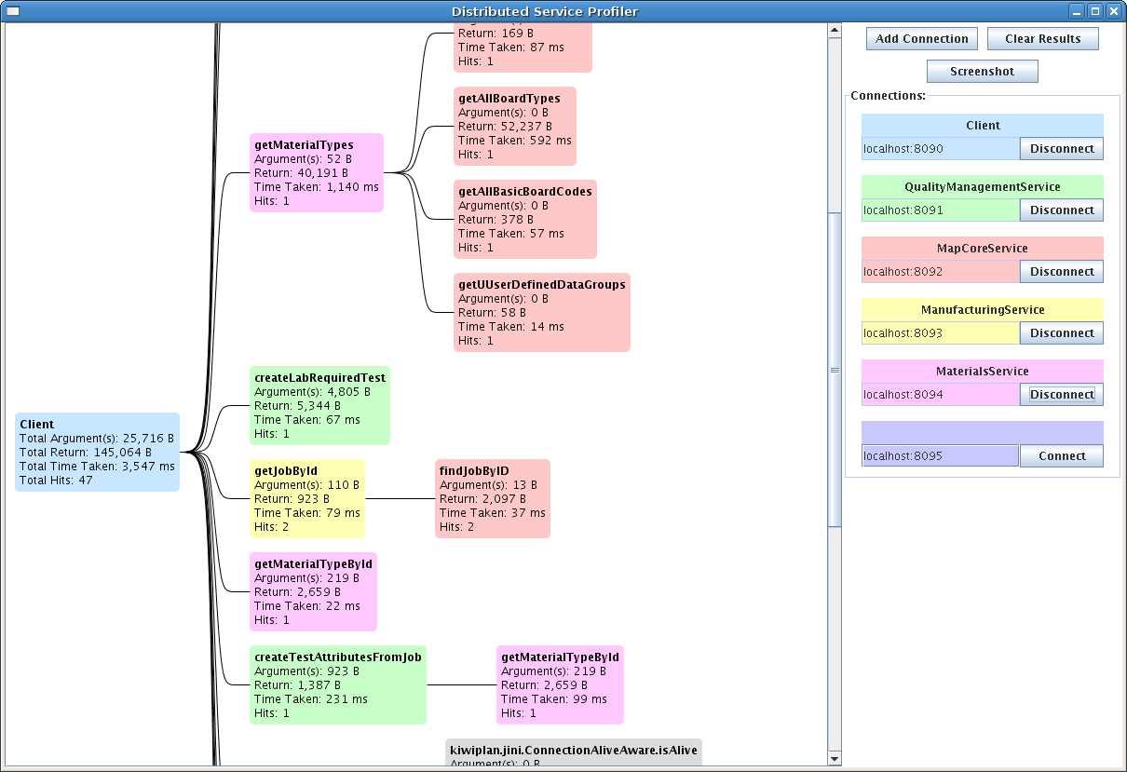
Profiler – Background Information

Slide 5
Profiler – How It Works
ServiceProfilerAgent(MBean) connects to various services using port number and registers to MBeanServer
Method calls are intercepted and information stored in notification which can then be emitted by MBean
Profiler uses JMX connector to find MBean and listen for incoming notifications
Each service will have an associated index

Slide 6
Profiler – How It Works
Information from the notification is extracted and stored in a MethodCallContainer
Method name, time taken to process, argument and return bytes and number of hits
Nodes are created, each containing an instance of the MethodCallContainer
Call tree is built up using the index from which the notification came from

Slide 7
Hibernate Interceptor
An interface in Hibernate which can be used in applications to react to certain events
Can be configured with an application and a database to intercept calls made to that database by the application
Will automatically be invoked every time a insert, delete etc query is made
Can create a class which extends the EmptyInterceptor class and only implement necessary methods

Slide 8
EmptyInterceptor
Interface which is part of the org.hibernate package
Is typically used by developers to extend to create a customized interceptor as only the neccessary methods are implemented
Methods I used - onSave(), onDelete(), onLoad(), onFlushDirty(), afterTransactionBegin() and afterTransactionCompletion()

Slide 9
JMX MBeans
Java Management Extensions is used to manage/monitor Java applications
Managed Beans are controllable endpoints of applications and can be used to expose attributes and operations
Once registered to the MBeanServer, the MBean will be exposed to the client

Slide 10
Notifications
MBeans can generate and emit notifications by extending NotificationBroadcastSupport
Contains source, sequence number, message etc
A client can extend NotificationListener to listen for and process incoming notifications.

Slide 11
Solution Overview
Service A
Method call
Service B
Jini
Method info.
Profiler
Intercept database queries
Send notification to profiler
Use MBean for communication
Hibernate

Slide 12
LoggerInterceptor Class
Set in Hibernate configuration (in PersistenceWrapper) to intercept database calls for that service
Has a boolean variable to switch logging on and off
When query is intercepted, the stack trace is passed on with the notification (using LoggerManager)

Slide 13
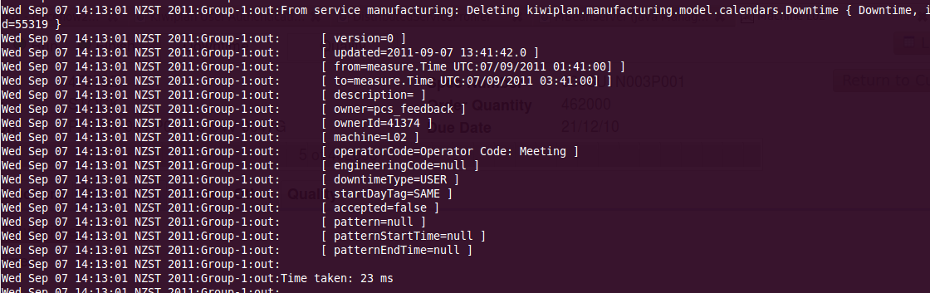
LoggerInterceptor Example
Injected interceptor into PersistenceWrapper to use with services. Simply prints out intercepted queries

Slide 14
LoggerManager(MBean) Class
Created by LoggerInterceptor
Used to communicate with the service profiler by extending MBeans
Registered to MBeanServer that the ServiceProfilerAgent uses – easier to query and find LM MBean
Profiler can then find the MBean and add a notification listener for it

Slide 15
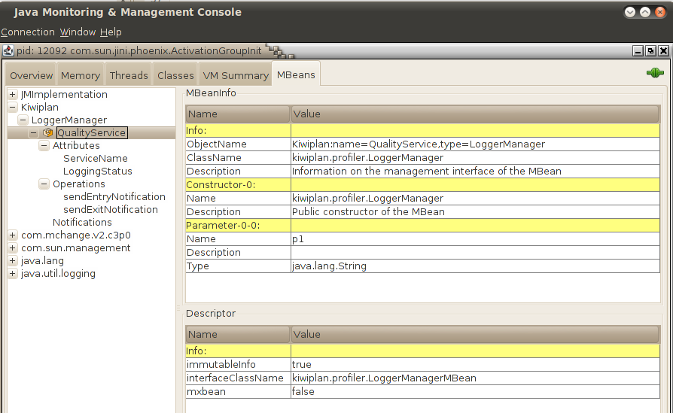
LoggerManager(MBean) Class
Emits notifications containing method name, time stamp and stack trace

Slide 16
Combining DB Calls with Service Calls
The stack trace from the interceptor actually goes back to the point where the service makes the method call
Thread.currentThread().getStackTrace() can be used to return an array of StackTraceElements
getClassName() and getMethodName() can be called on each element

Slide 17
Combining DB Calls with Service Calls
Service method calls are stored as tree nodes – database calls would originate from leaf nodes
Can check method names from list of leaf nodes with methods from stack trace
Once the calls are matched, a new node can be created containing the database call and connected to the service method call node

Slide 18
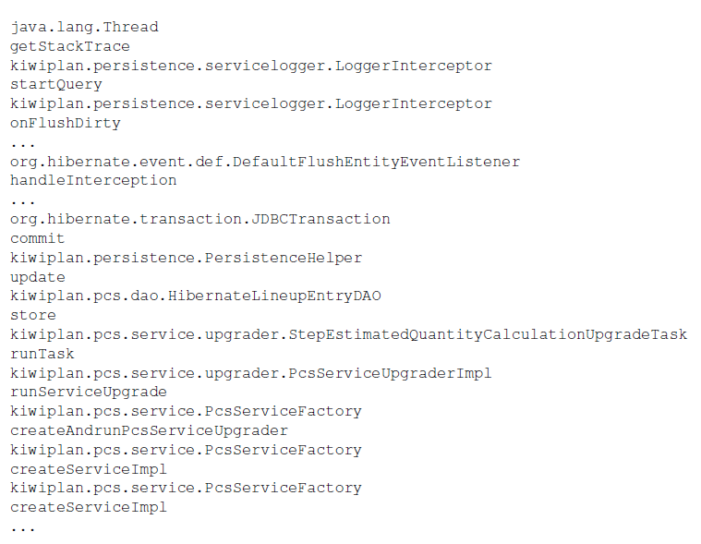
Combining DB Calls with Service Calls
Example open method nodes and stack trace output from interceptor
Can compare method names from service methods in list of open nodes with method names in stack trace

Slide 19
Conclusion
Unfortunately I did not complete all the implementation of the design
Overall I have completed the interception of database queries, passing this information to the profiler with using an MBean and found how to match these queries to the original method call

Slide 20
Future Work
Missing implementation:
Creating node for database query
Integrating it with existing call tree
Will need to create a new container for queries – could extend current one – to account for database information
Changes to GUI – displaying new nodes, switch logging on/off etc
Testing

Slide 21
Problems Encountered
Hibernate, JMX, MBeans etc were all new concepts
A lot of the time was spent doing research/online tutorials instead of coding for the actual project
Service profiler uses classes found in different projects
Didn’t realise it used MBeans for communication (was in a diff. project)
Had to think about the dependencies of the project
MBeans registering in different places

Slide 22
What I Have Gained
Knowledge on various frameworks such a Hibernate, MBeans, JMX, etc
Experience with working on an actual project in a company – need to think about how different projects relate to each other
Development process
Documentation/commenting is important
Planning a solution

Slide 23
Acknowledgements
Thank you to everyone involved in this project
Especially my industry and academic mentors - Edward and Xinfeng

Slide 24
Thank You.
Questions?

